Slide 1
Feature Selection
Prepared By: Dr. Ronak Panchal (Ph.D.)
IT Project Manager, Cognizant
Adjunct Professor, RNGPIT
Website: http://drronakpanchal.wordpress.com

Slide 2
Agenda
Need for Feature Selection
What is Feature Selection?
Importance of Feature Selection
Feature Selection statistics
Feature Selection Techniques with Hands-On
Advantage of Feature Selection
Disadvantage of Feature Selection
Reference

Slide 3
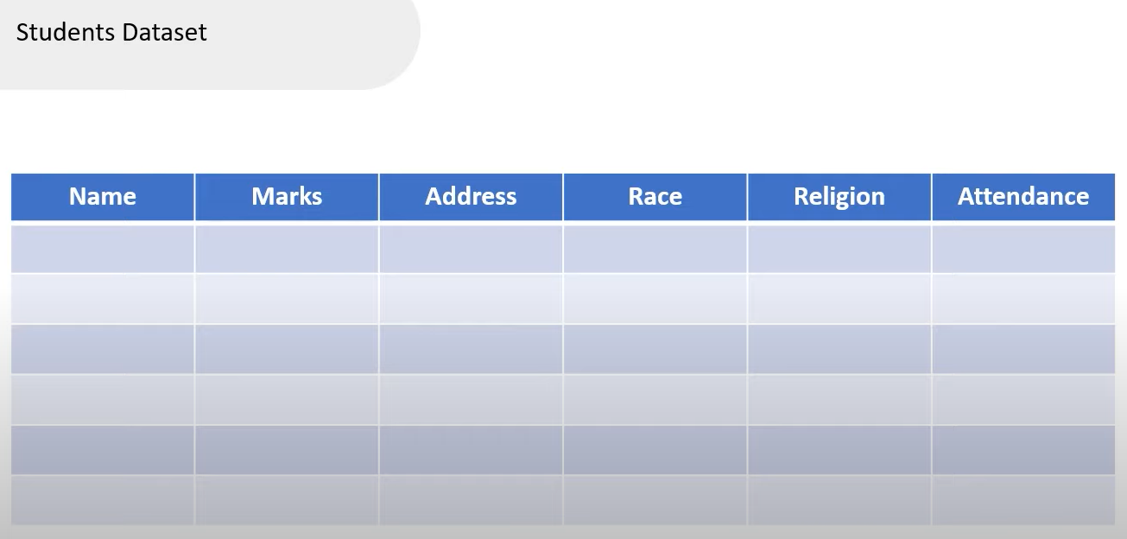
Need for Feature Selection

Slide 4
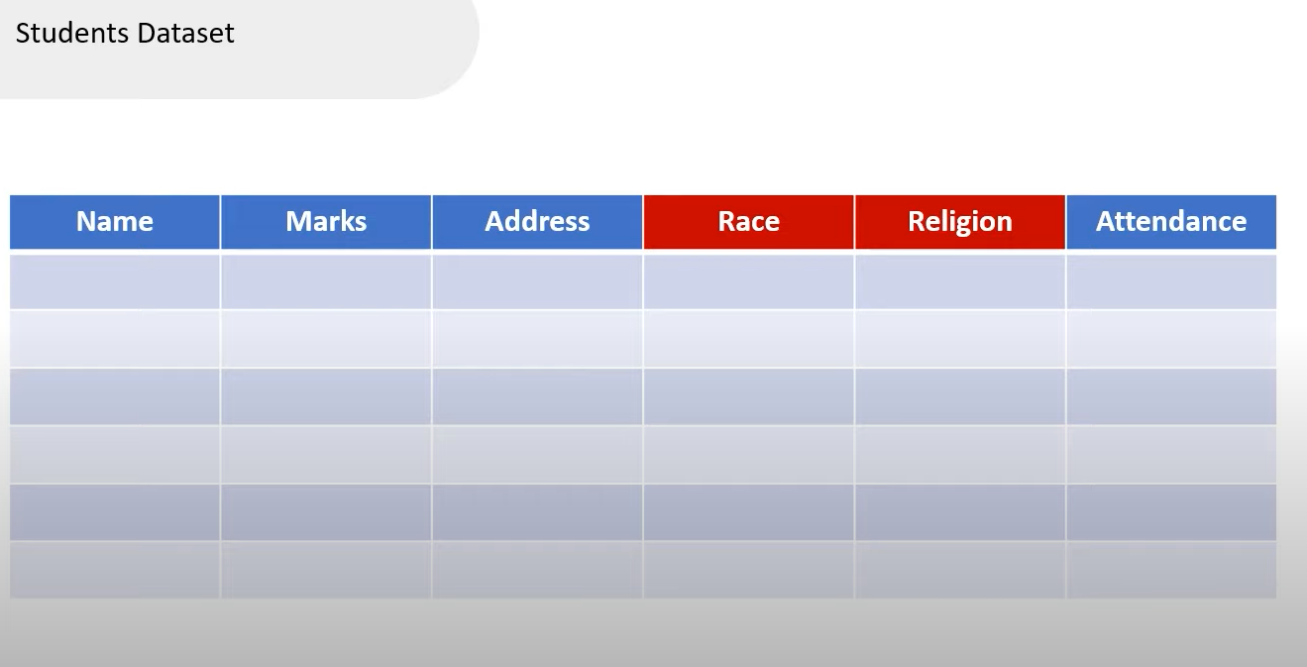
Need for Feature Selection

Slide 5
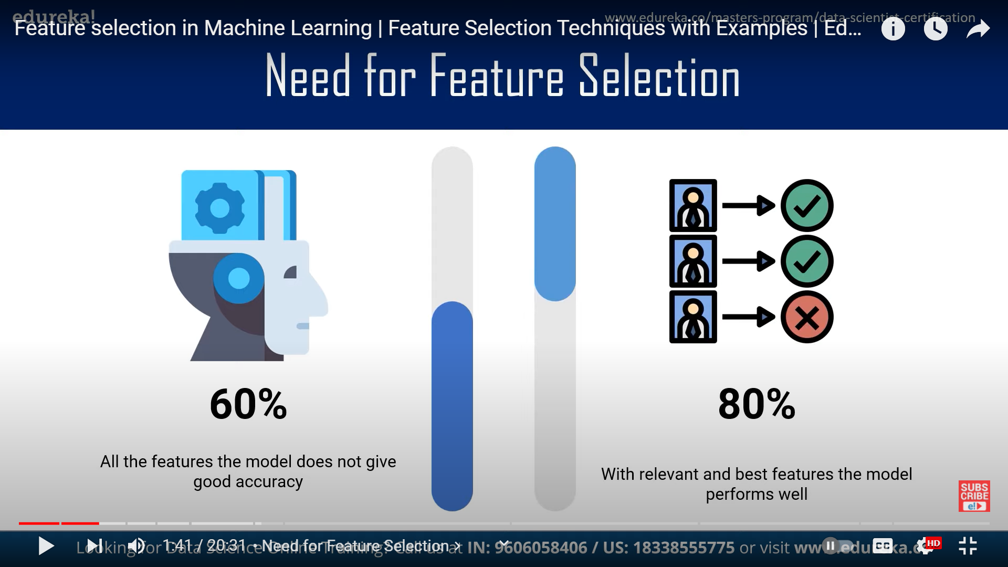
Need for Feature Selection

Slide 6
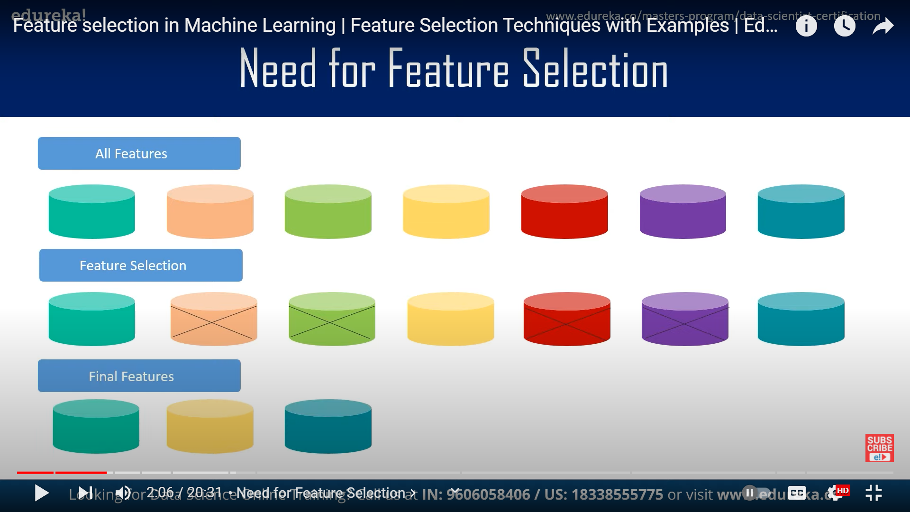
Need for Feature Selection

Slide 7
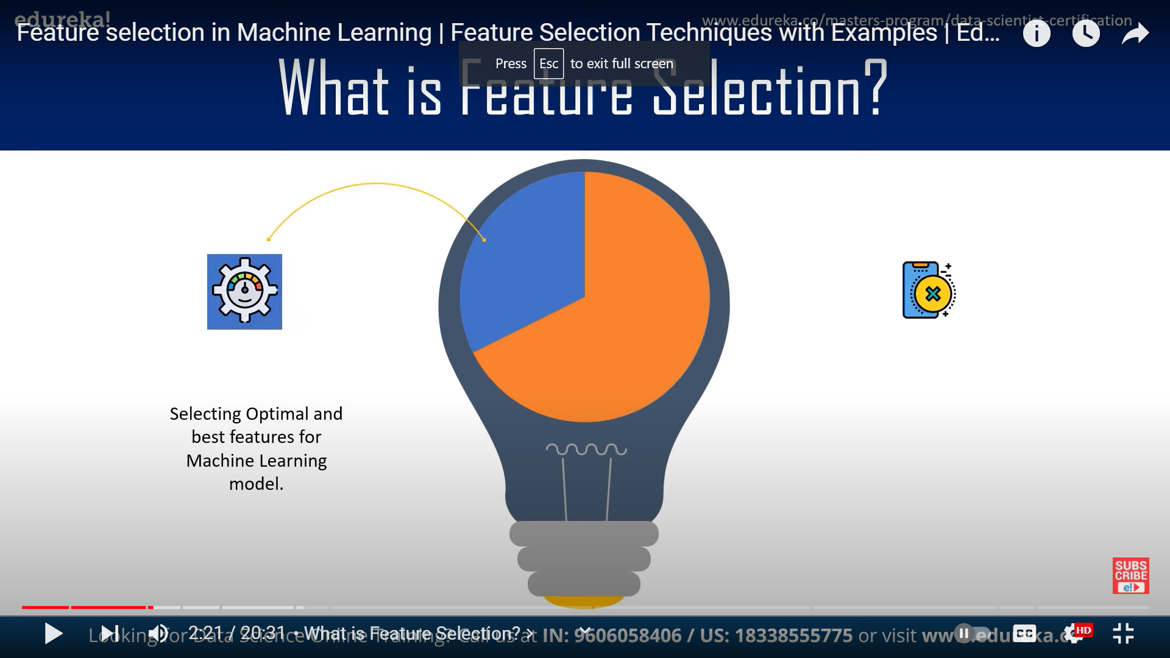
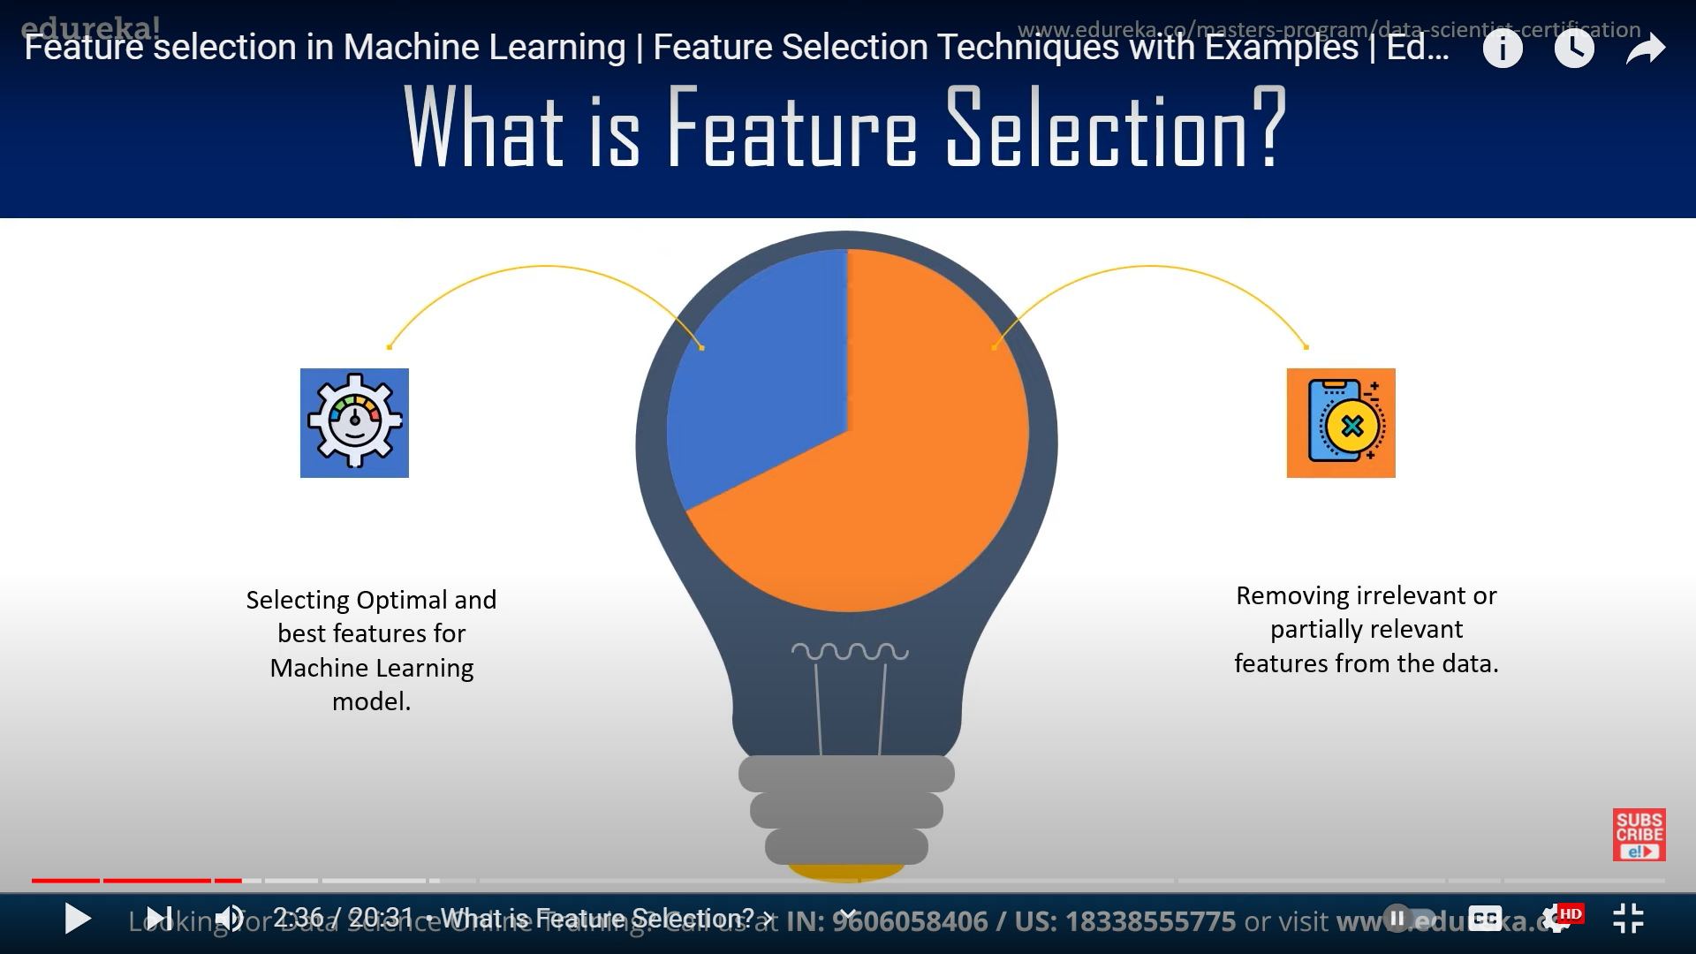
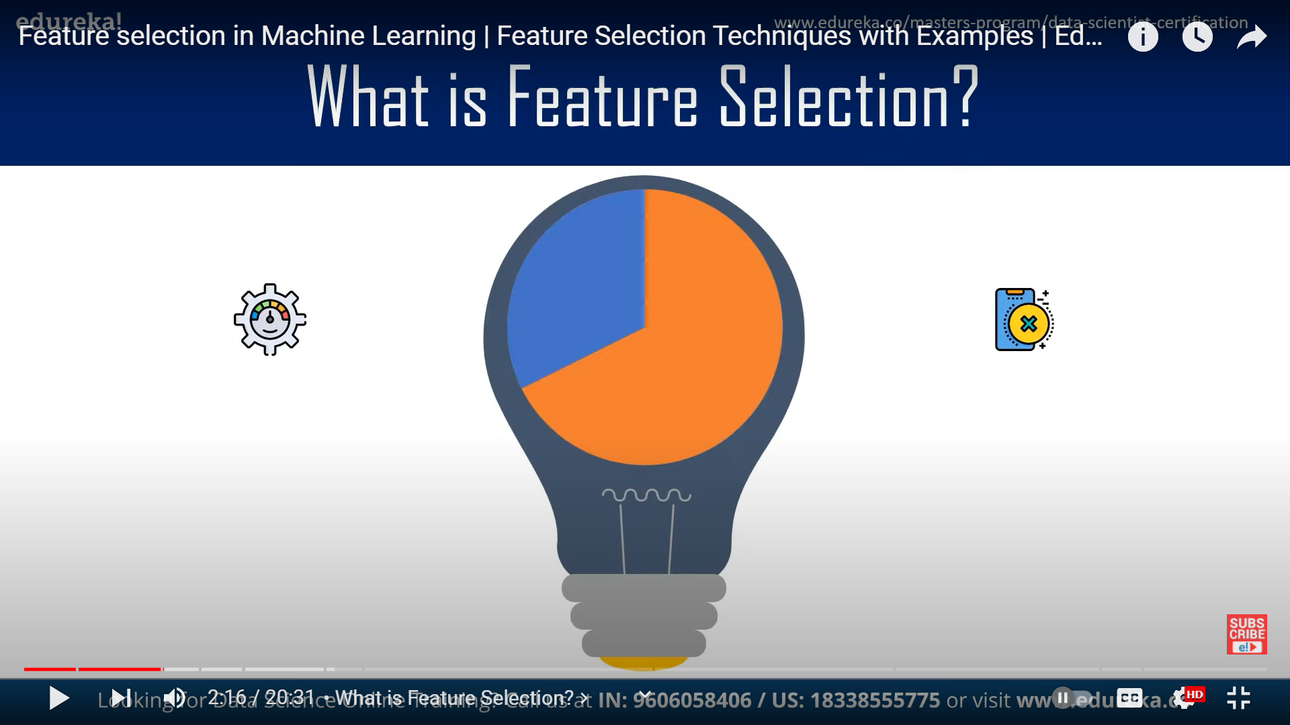
What is Feature Selection?

Slide 8
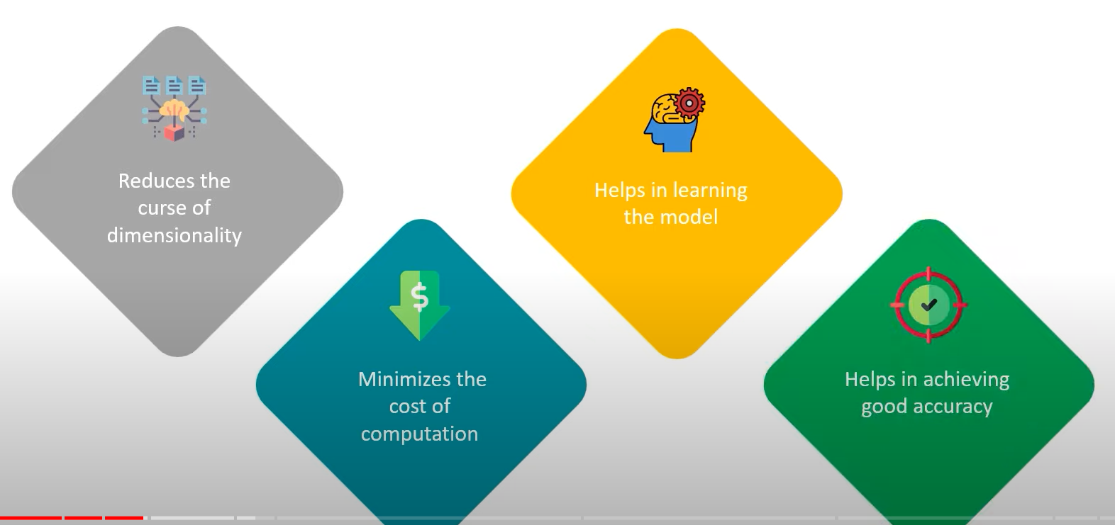
Importance of Feature Selection

Slide 9
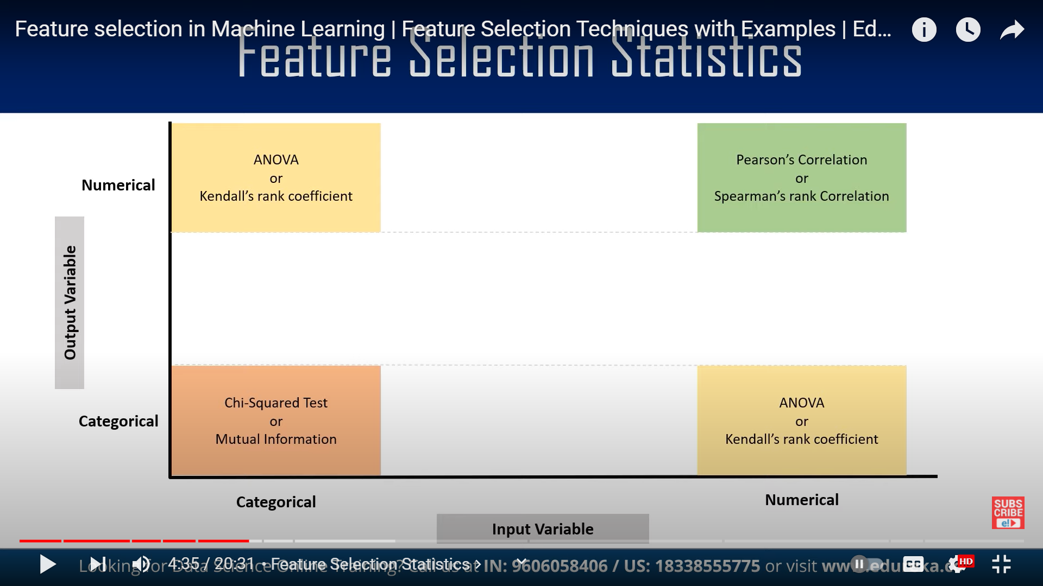
Feature Selection Statistics

Slide 10
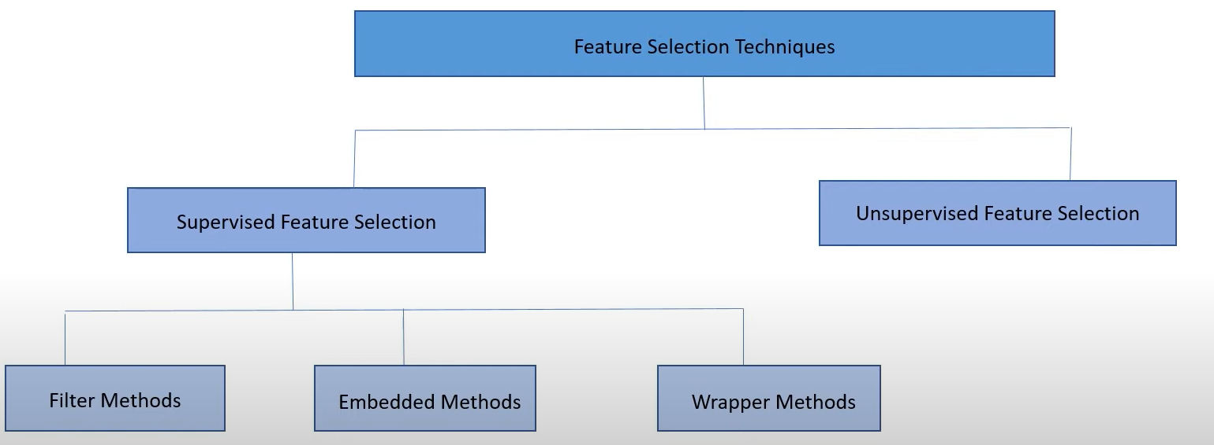
Feature Selection Techniques

Slide 11
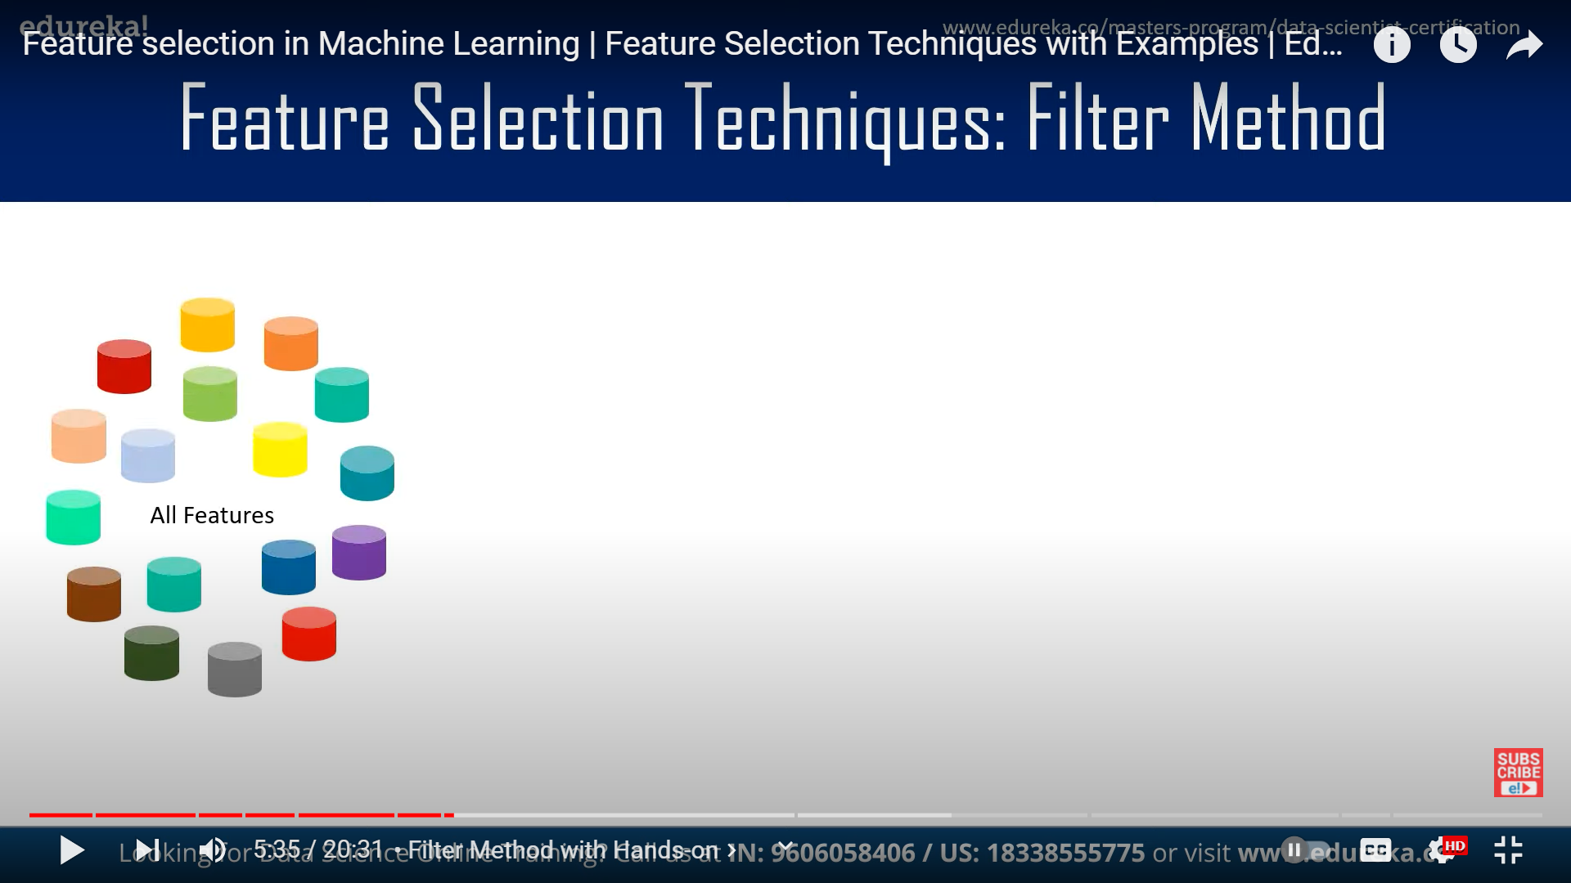
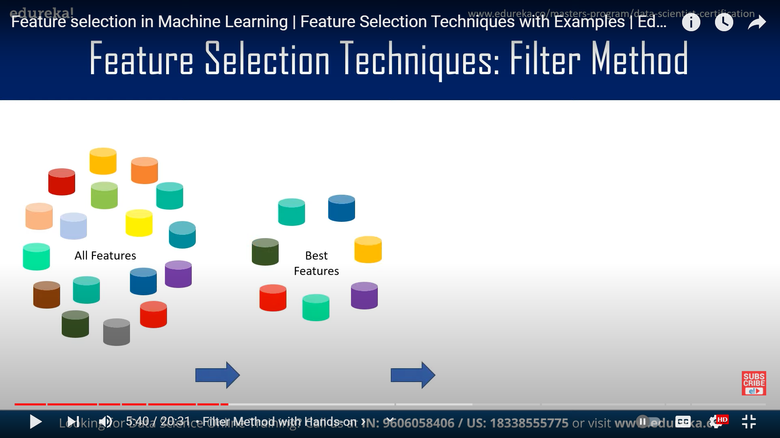
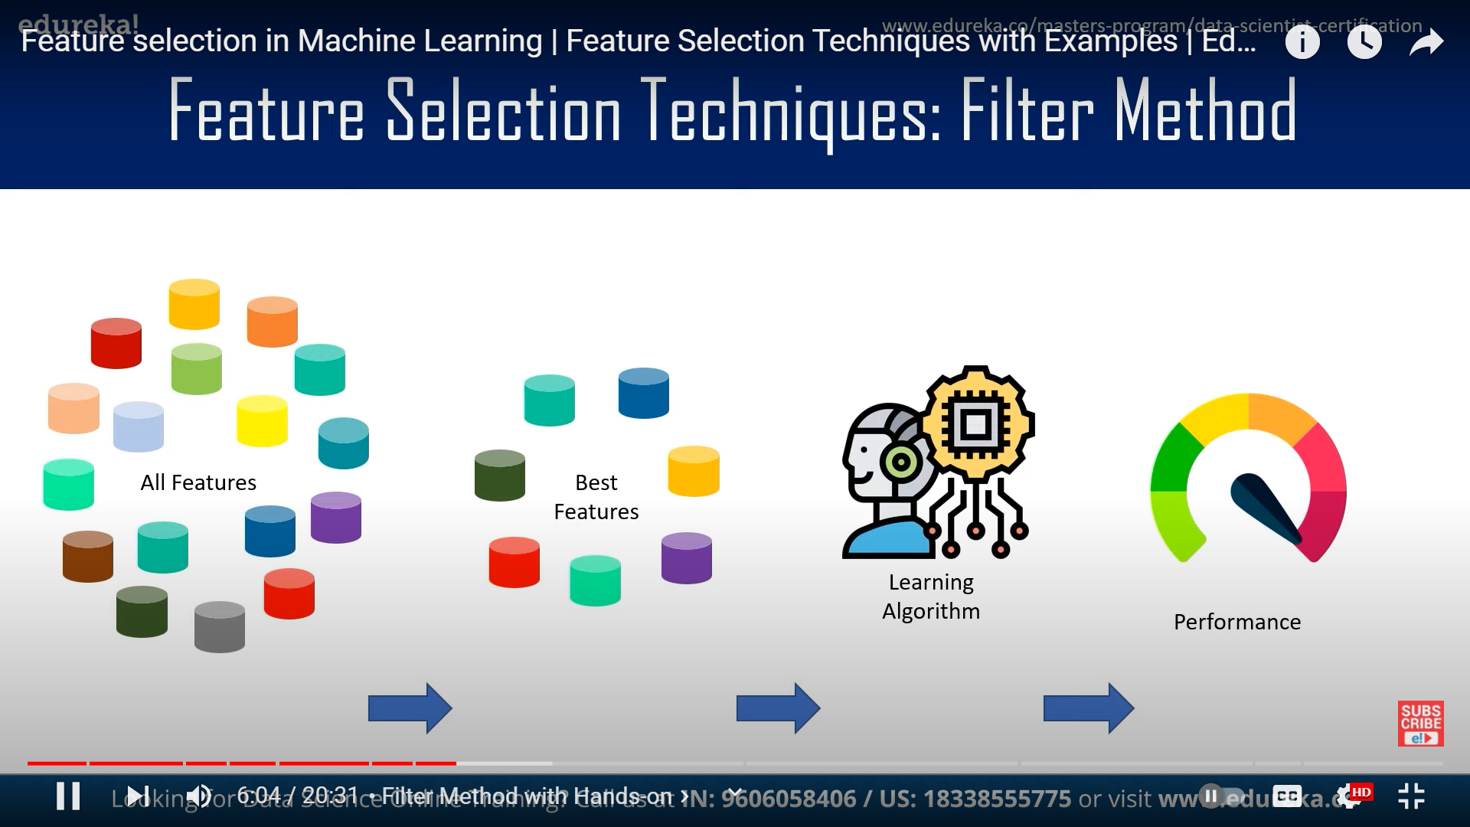
Feature Selection Techniques: Filter Method

Slide 12
Filter Methods techniques
Information Gain
Reduction determines in Entropy
Chi-Squared test
Determines the relationship between categorical variables.
Fisher’s Score
(F-Score)
Returns the rank of the feature in descending order
Missing Value Ratio
Evaluate the feature set against threshold value.

Slide 13
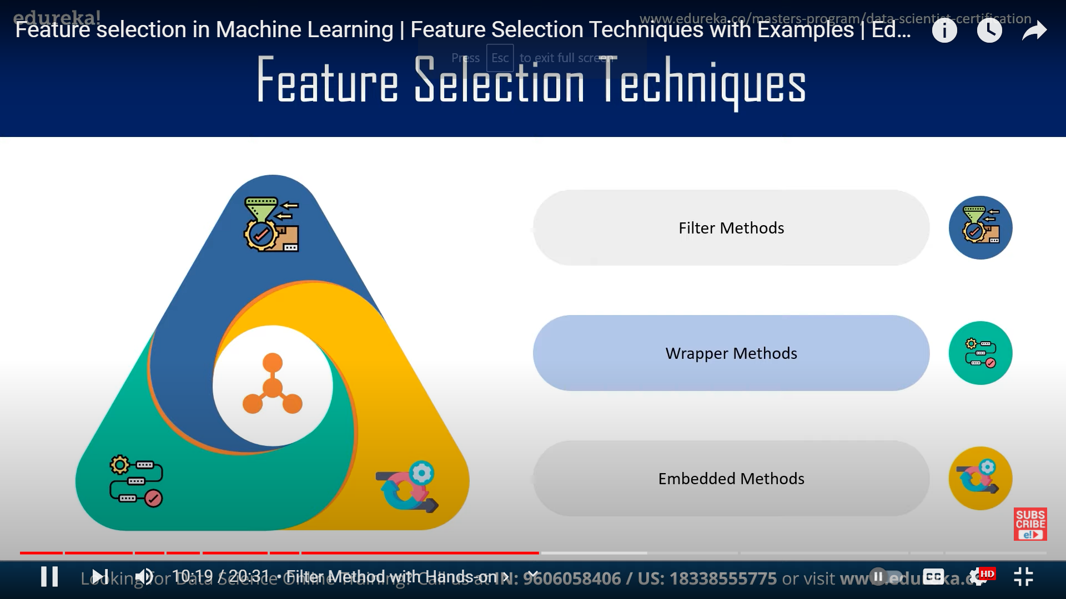
Feature Selection Techniques

Slide 14
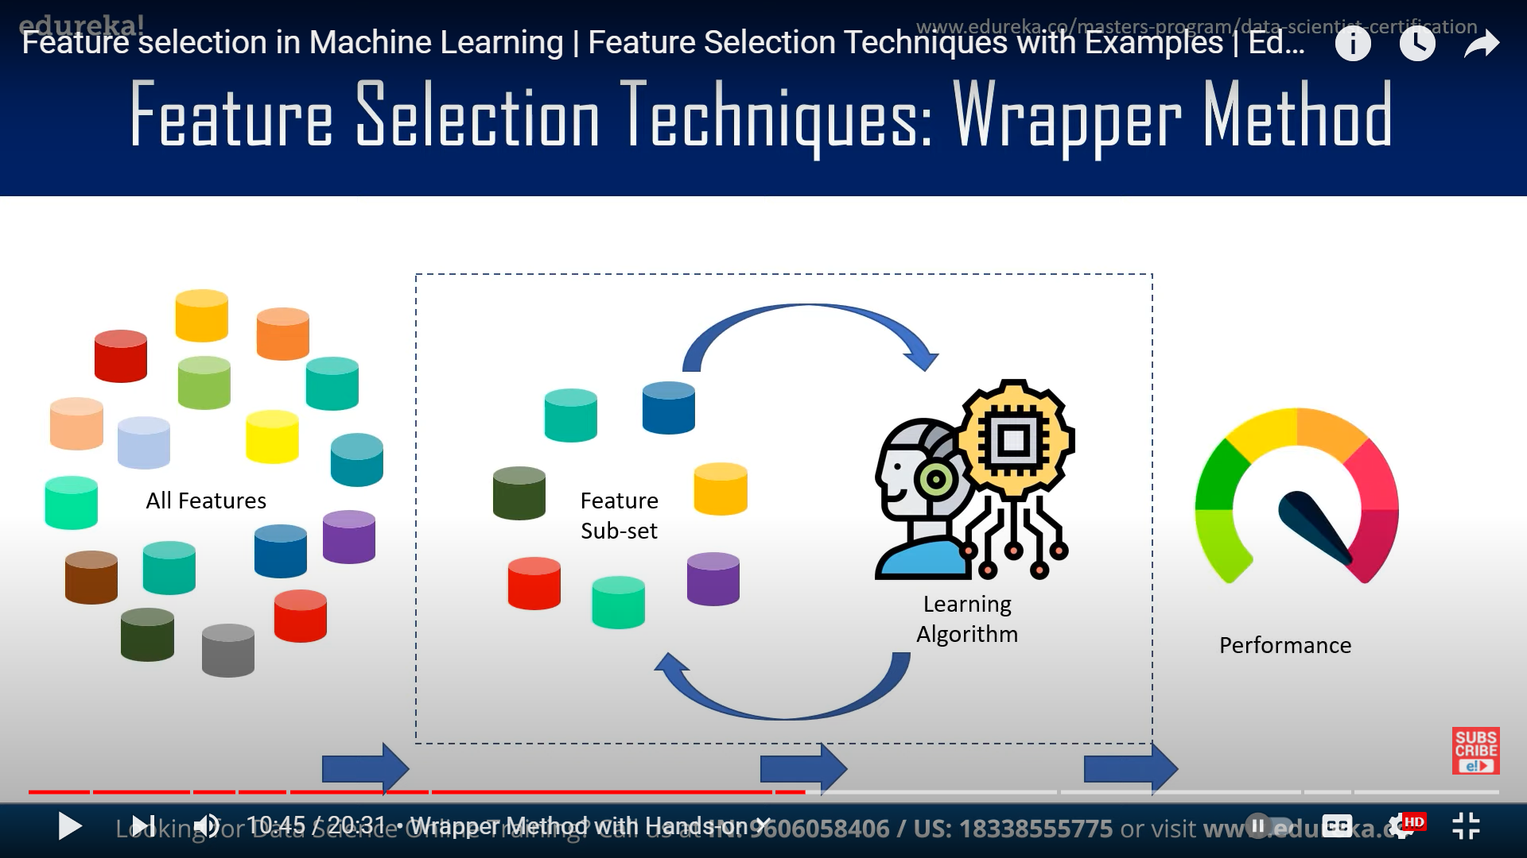
Feature Selection Techniques: Wrapper Method

Slide 15
Wrapper Method techniques
Forward Selection
Begins with empty set of features, with each iteration keeps adding on features and evaluation.
Backward Elimination
Begins with all the features, with each iteration removes the least significant features.
Recursive Feature Elimination
It is a recursive greedy optimization approach.
Exhaustive Feature Selection
Evaluation is based on brute-force method.

Slide 16
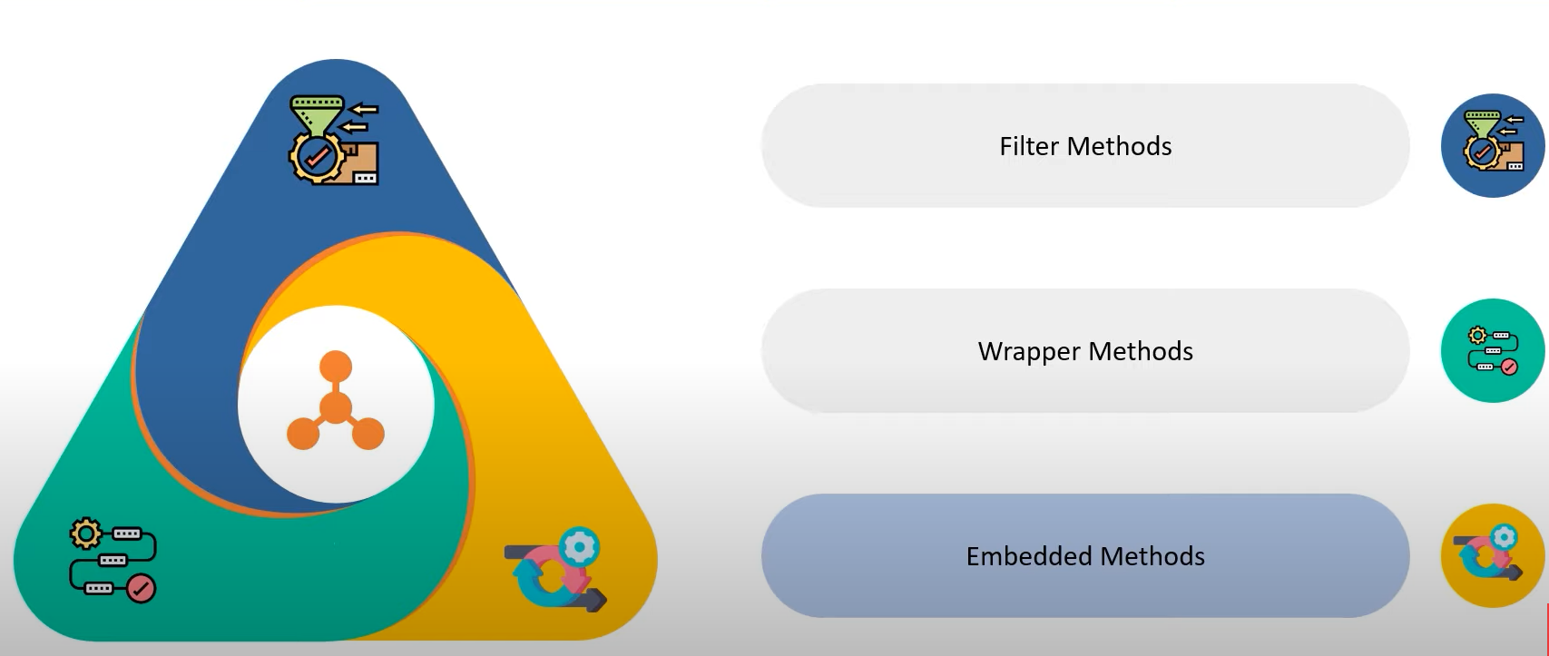
Feature Selection Techniques: Embedded Method

Slide 17
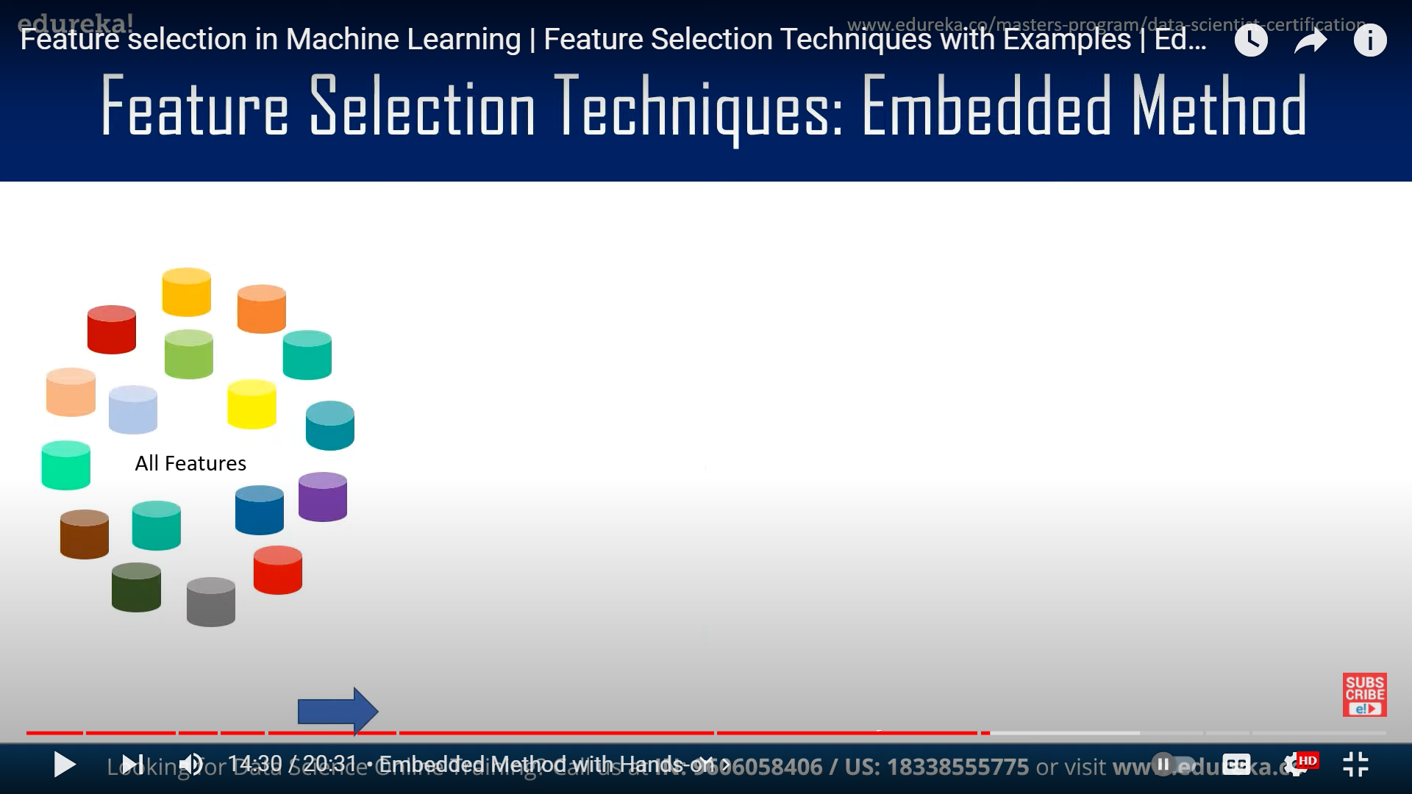
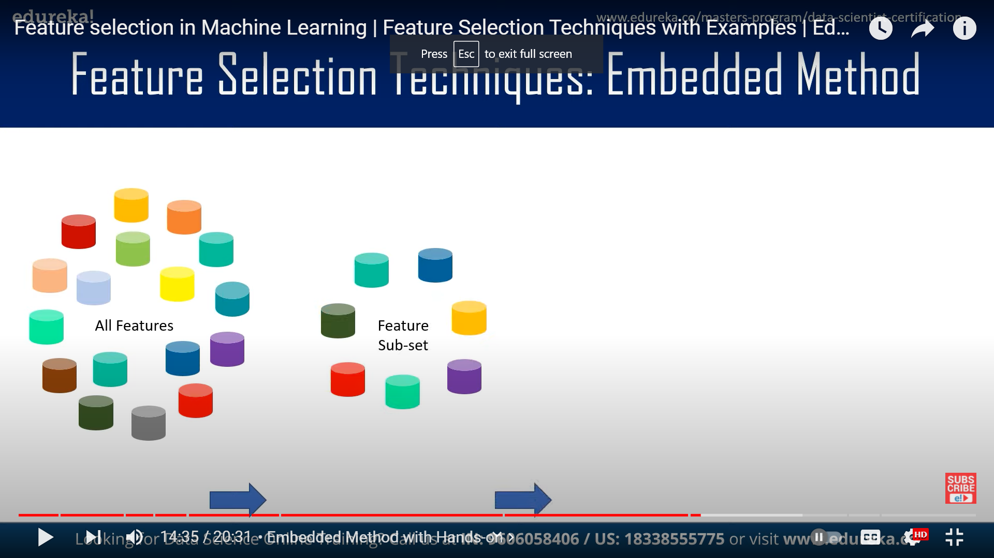
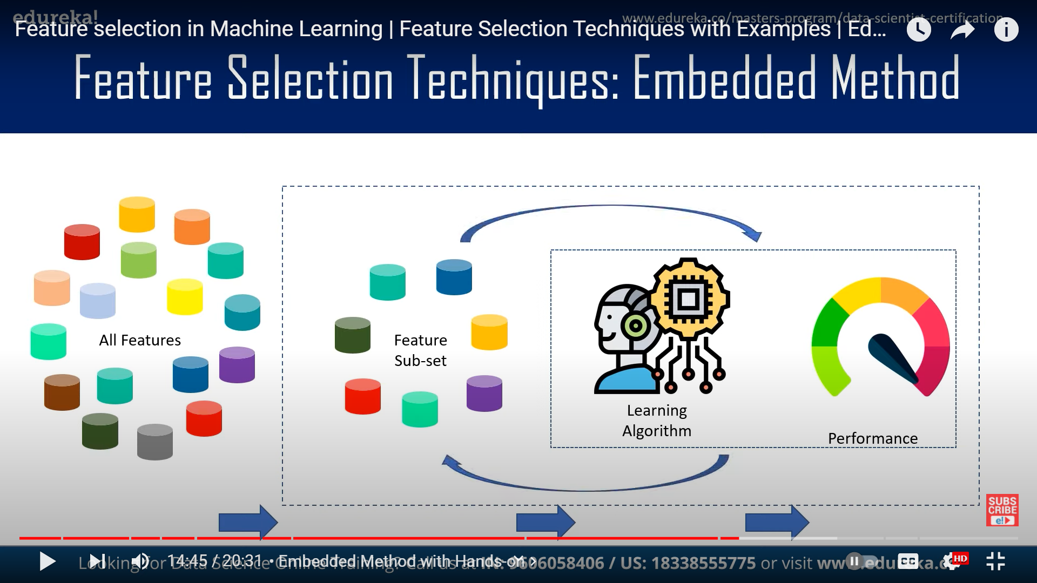
Feature Selection Techniques: Embedded Method

Slide 18
Embedded Method Techniques
1
Regularization techniques like L1(Lasso and lassor regression), L2(lasso and ridge) or Elastic Nets
2
Random Forest, Tree based Methods(Decision tree) for feature selection

Slide 19
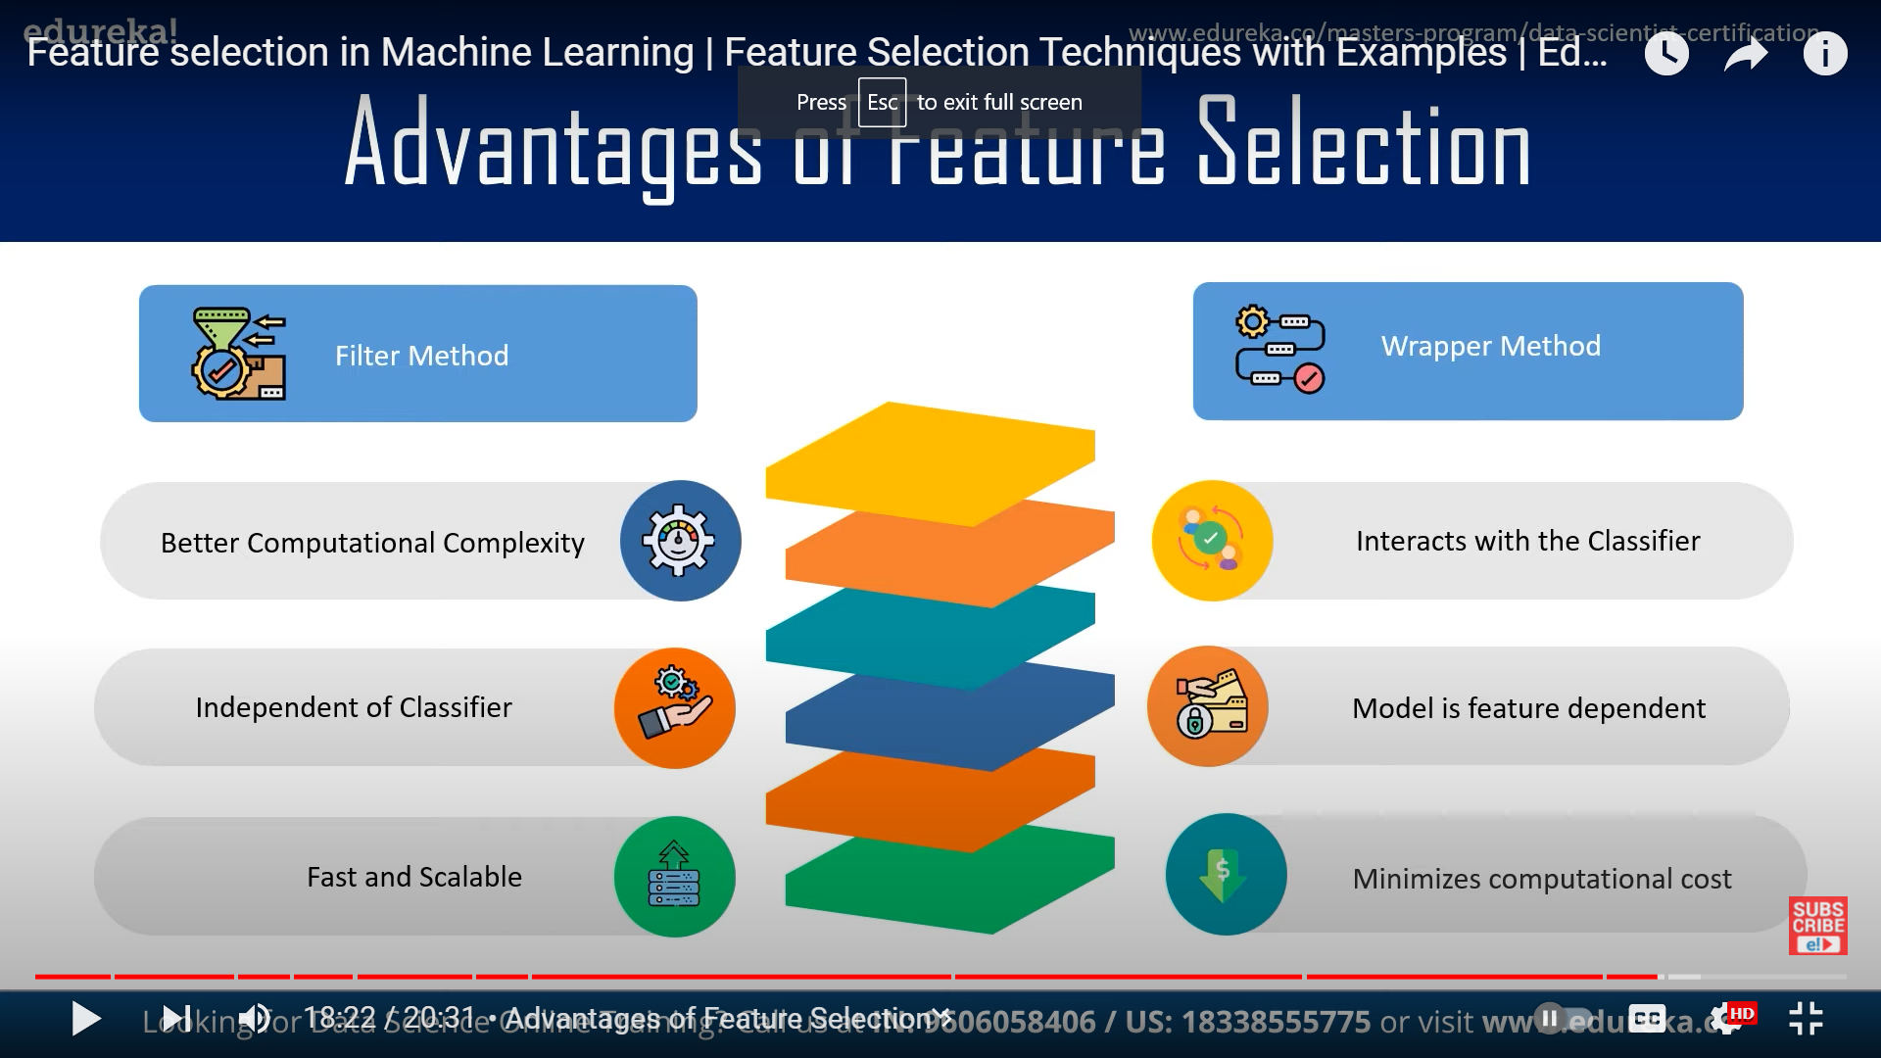
Advantage of Feature Selection

Slide 20
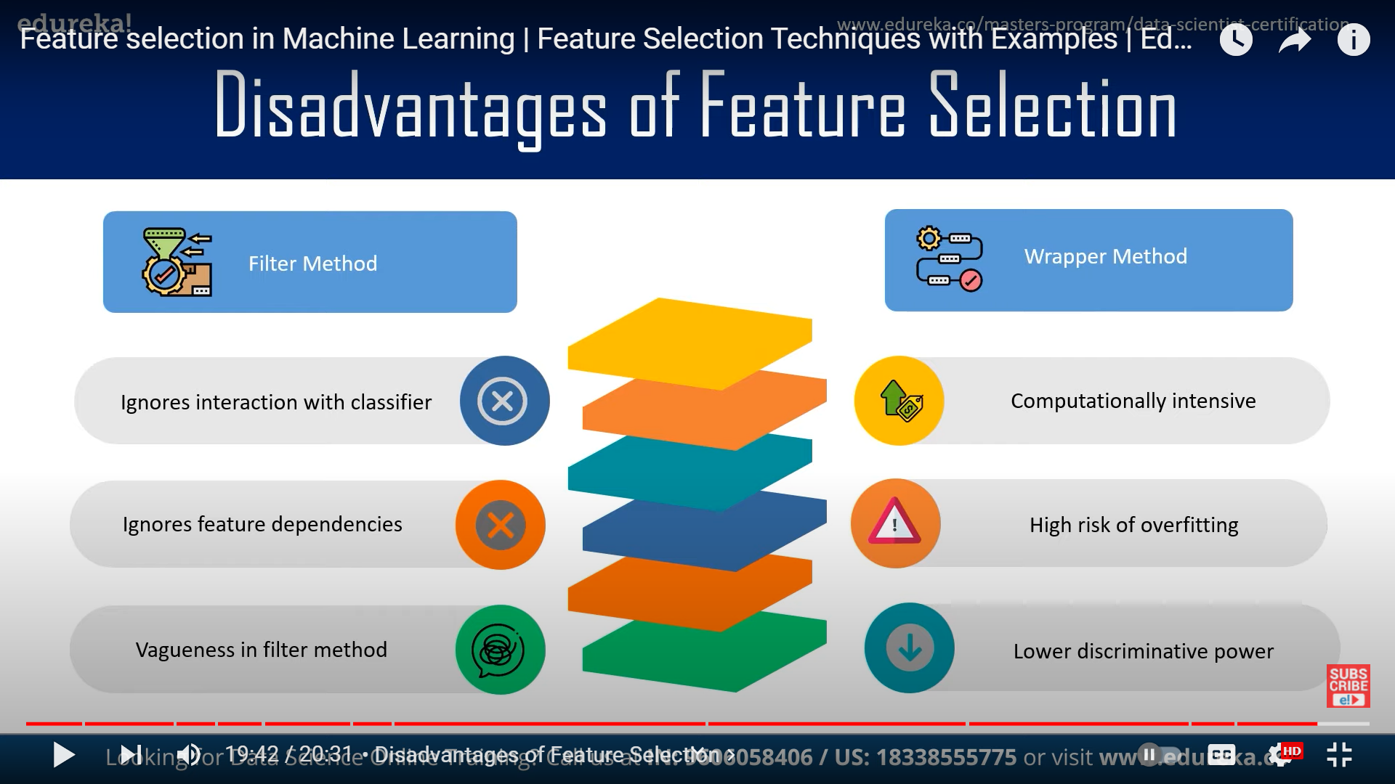
Disadvantage of Feature Selection

Slide 21
Reference
https://www.youtube.com/watch?v=eciABhWBiUc
https://towardsdatascience.com/how-machine-learning-can-help-with-customer-retention-6b5bf654e822
https://brendanhasz.github.io/2019/04/04/loyalty-prediction-2-features.html
https://www.analyticsvidhya.com/blog/2020/10/feature-selection-techniques-in-machine-learning/
https://thesai.org/Downloads/Volume9No2/Paper_38-Machine_Learning_Techniques_for_Customer_Retention.pdf
https://www.projectpro.io/article/8-feature-engineering-techniques-for-machine-learning/423
https://www.upskillpoint.com/machine%20learning/2020/03/11/feature-selection-using-embedded-method/
https://www.analyticsvidhya.com/blog/2016/01/ridge-lasso-regression-python-complete-tutorial/

